Slide 1


EDA : FIRST INTERN PROJECT
Presented by : Salah Naimat
Ahmad Salah

Slide 2
Hotel Booking Dataset
Description: This dataset analyzes hotel booking behavior to support strategic and operational decision-making. It covers customer profiles, stay patterns, booking channels, pricing, and cancellation behavior. Business Value • Identify key customer segments and repeat guests • Analyze cancellation risk and demand patterns • Support pricing, capacity planning, and channel performance optimization
-
01

Slide 3
02
Data Processing
01
we add 2 new column :
1.'number of family members'='number of children'+'number of adults'.
2.'number of nights per reservation'='number of week nights'+'number of weekend nights'
02
1.transformation Room type, booking status, market segment type, type of meal from categorical to numerical values.
2.parsing the year and the month from each date of reservation
3. dropping the data of date of reservation from 2015 & 2016
Ahmad Salah
-
EDA
-
Salah Naimat

Slide 4
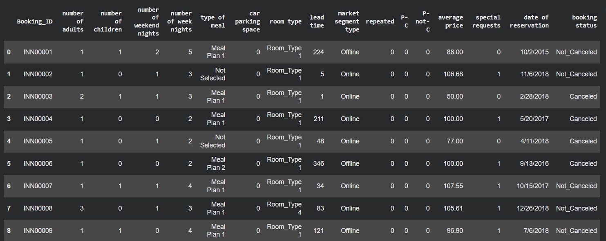
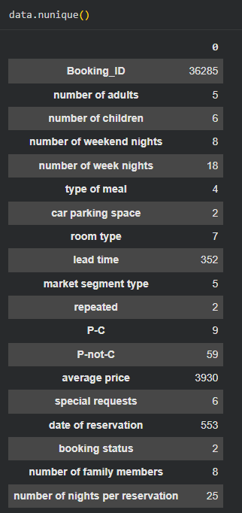
03
Our Initial Data frame
EDA
Ahmed Salah - Salah Naimat

Slide 5
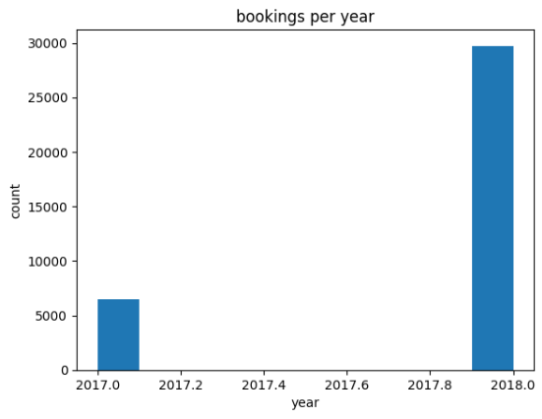
Plots and Graphs
EDA
04
Ahmed Salah - Salah Naimat

Slide 6
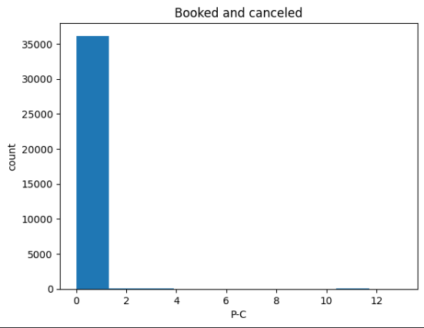
Plots and Graphs
EDA
05
Ahmed Salah - Salah Naimat

Slide 7
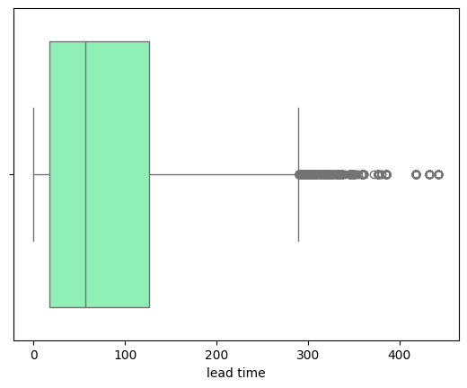
Plots and Graphs
EDA
06
Ahmed Salah - Salah Naimat

Slide 8
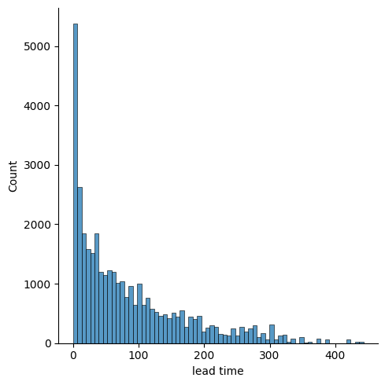
Plots and Graphs
EDA
07
Ahmed Salah - Salah Naimat

Slide 9
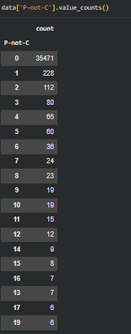
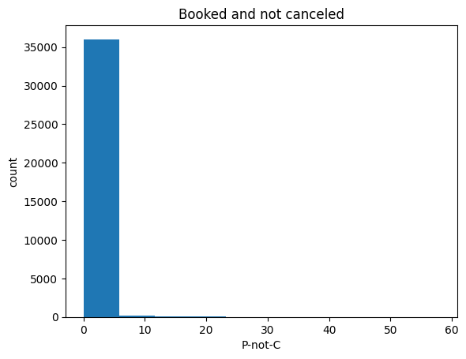
Plots and Graphs
EDA
08
Ahmed Salah - Salah Naimat

Slide 10
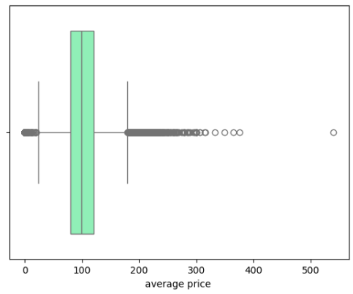
Plots and Graphs
EDA
09
Ahmed Salah - Salah Naimat

Slide 11
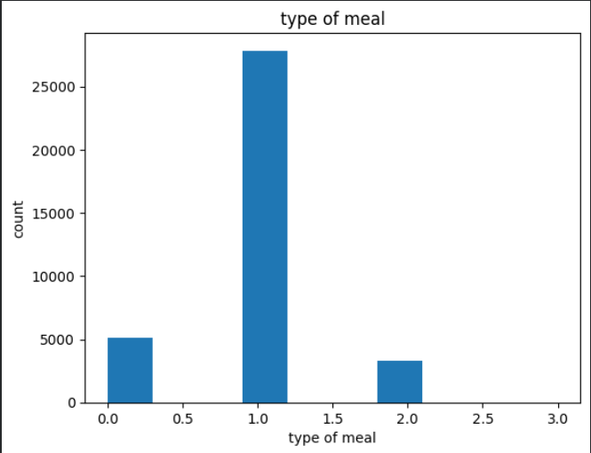
Plots and Graphs
EDA
10
Ahmed Salah - Salah Naimat

Slide 12
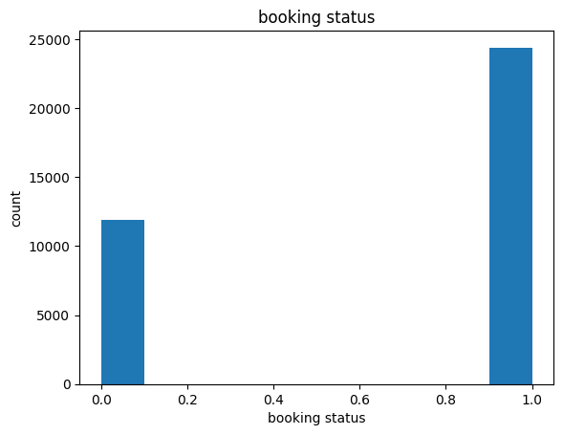
Plots and Graphs
EDA
11
Ahmed Salah - Salah Naimat

Slide 13
Plots and Graphs
EDA
12
Ahmed Salah - Salah Naimat

Slide 14
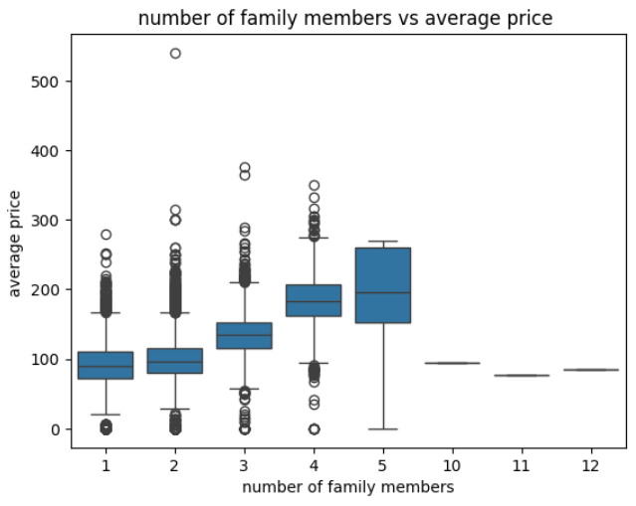
Plots and Graphs
EDA
13
Ahmed Salah - Salah Naimat

Slide 15
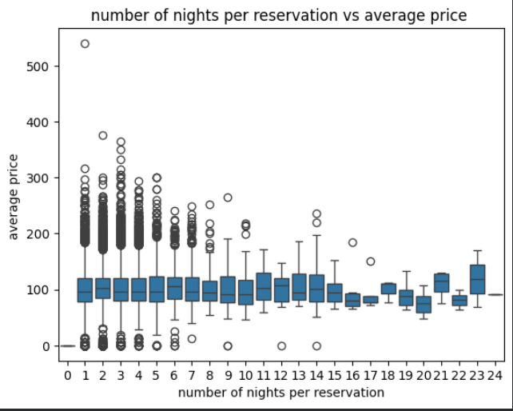
Plots and Graphs
EDA
14
Ahmed Salah - Salah Naimat

Slide 16
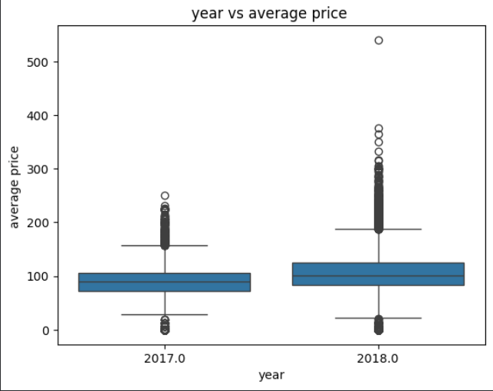
Plots and Graphs
EDA
15
Ahmed Salah - Salah Naimat

Slide 17
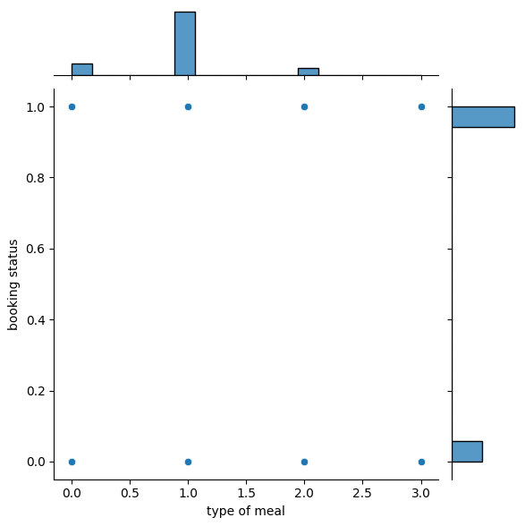
Plots and Graphs
EDA
16
Ahmed Salah - Salah Naimat

Slide 18
Plots and Graphs
EDA
We want to present the:
PAIR PLOT
17
Ahmed Salah - Salah Naimat

Slide 19
Ahmad Salah,Salah Naimat
-
EDA
18
future steps
Modeling:
Creat A Machine Learning Model .

Slide 20
Ahmad Salah
-
EDA
-
Salah Naimat
Thank You

